Slide 1
Instant Messaging Application to share confidential messages using Image Steganography.
A SECURE WAY OF MESSAGING
GROUP 8
Prudhvinath Reddy Katha | Madan Kumar Sutapalli | Vijay Durgesam
Supervised By:
Maha Ali Allouzi, PhD

Slide 2
CONTENTS
Abstract
Literature Review
Architecture & Use Case Diagram
Implementation – A Focus on Security & Storage
End to Encryption, AES – Algorithm & Image Steganography
Technologies Used
Challenges & Limitations
Outputs
Future Work
Conclusion
Reference

Slide 3
abstract
Secure Chat is an innovative approach to communication, focusing heavily on storage, security and integration with image scanning. Our team has focused on developing a product that will stand out in the market, rather than creating another typical chat application. We've started by prioritizing the creation of a Clean and User-friendly Interface. We have effectively used Angular, JS, and Firebase to achieve this objective, drawing inspiration from a variety of existing applications. They all work on their own, and we've been trying to combine them to get a Web Secure Chat application.
The image steganography function is one of the best features in this project which stands out from other features, it provides a new way to hide text from easy and plain pictures. It is a best way to secretly send messages to your friend or colleague in an image.
This project aims to develop a comprehensive end-to-end encryption framework for messaging web applications. It will incorporate features such as End-to-End encryption, and AES cryptography algorithm to ensure security and efficiency. Furthermore, the project will enhance security by integrating Image Steganography to share confidential messages securely.

Slide 4
Literature Review
A significant focus has been given to improving digital communications security in recent years. Nurhayati, Kastari and F. Fahrianto (2022) explored the implementation of end-to-end encryption (E2EE) on Android-based instant messaging applications using the AES cryptography algorithm, stating that "their study demonstrated the effectiveness of E2EE in securing text messages" (Nurhayati et al., 2022).
Similarly, Neogi’s (2022) investigation of the E2EE system in WhatsApp revealed details on its functioning and implications for security. Beyond encryption, Williamson (2021) discussed the importance of multi-factor authentication (MFA) in modern security systems, highlighting its role in enhancing protection against unauthorized access. Shirvanian and Agrawal (2021), the creators of 2D-2FA, a novel approach to two factor authentication, have renewed this concept.
Meanwhile, Subramanian et al. (2021) reviewed recent advances in image steganography, emphasizing its role as an additional layer of security. Finally, Chandani and Sharma (2023) proposed cryptographic solutions for ensuring data integrity and confidentiality which addressed the need to secure transmission of information in Internet of Things (IoT) or sensor networks. These studies are a collective contribution to the efforts being made in order to enhance safety of communication and data transmission.

Slide 5
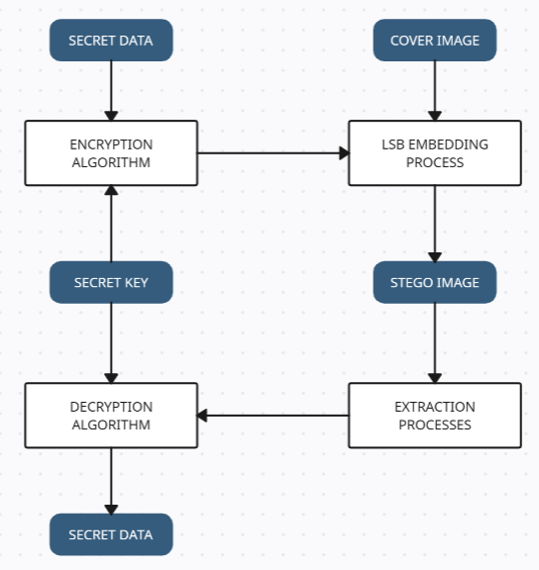
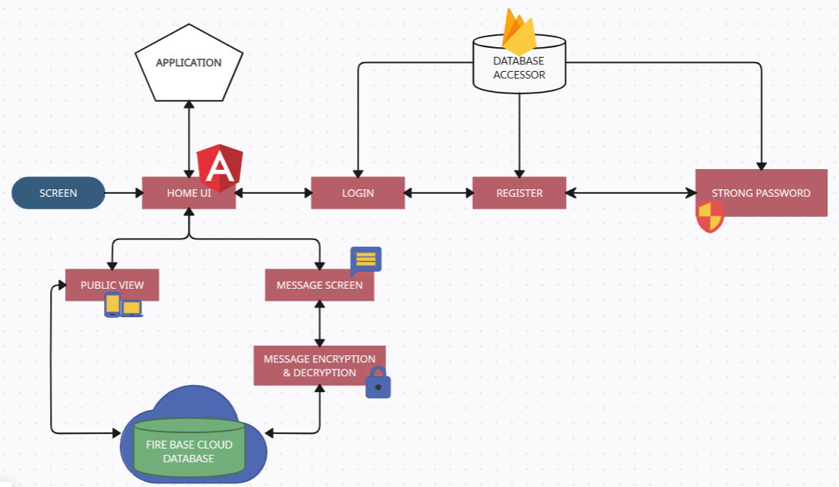
Architecture
Sample Chat Application Architecture
Image Steganography Architecture

Slide 6
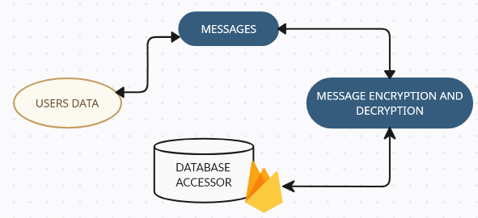
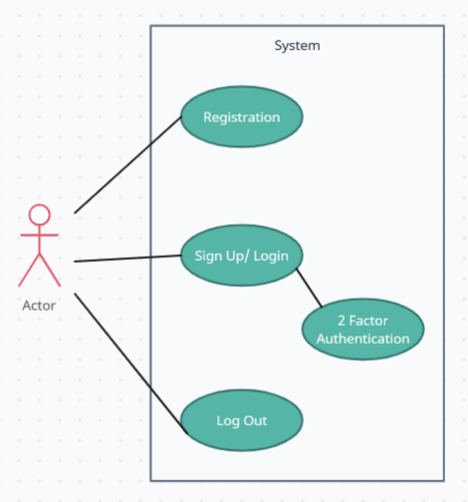
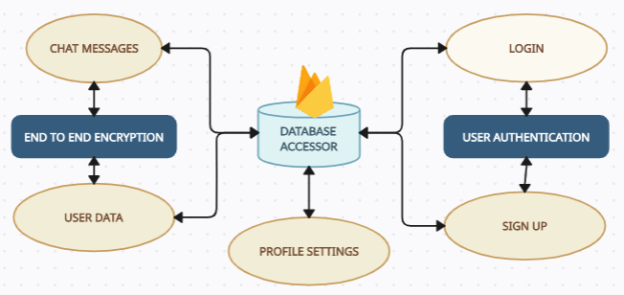
Use Case Diagrams
End to End Encryption
Authentication flow
Different component connection to database

Slide 7
Implementation – A Focus on Security & Storage
A Sample Implementation steps include:
Install Node.js for building & developing angular project and manage angular code dependencies
Setting up the firebase (login, creating project and getting environment details)
Constructing all the angular components and start connecting to firebase by using the environment details received from firebase after project creation.
Implement AES using CryptoJS.
End-to-End encryption of messages implementation.
Encode and Decode function for hiding text under an image using LSB algorithm
For access control, use Firebase Security Rules.
Frontend – GUI - Angular
Developed the user interface by using angular where we had multiple components like home-page component, sign-up component, profile-page component, landing-page component, environments etc.
Each component does their work when called using type scripts.
Backend – Database - Firebase
Firebase's the back end support. To use some of the services such as authentication, storage, database.
Database is organized based on owner requirements and has the ability to query among the data.
Notes:
A Sample Implementation steps include:
Setting up Firebase to store and authenticate on the backend.
Node.js installation
Implement AES encryption for end-to-end encryption of messages.
Encode and Decode function for hiding text under an image using LSB algorithm
To provide additional safety, you can use 2FA.
For access control, use Firebase Security Rules.
To ensure that the application is connected to HTTPS at all times.
Secure login and logout processes must be implemented.
Stay up to date with the latest security best practices and updates.

Slide 8
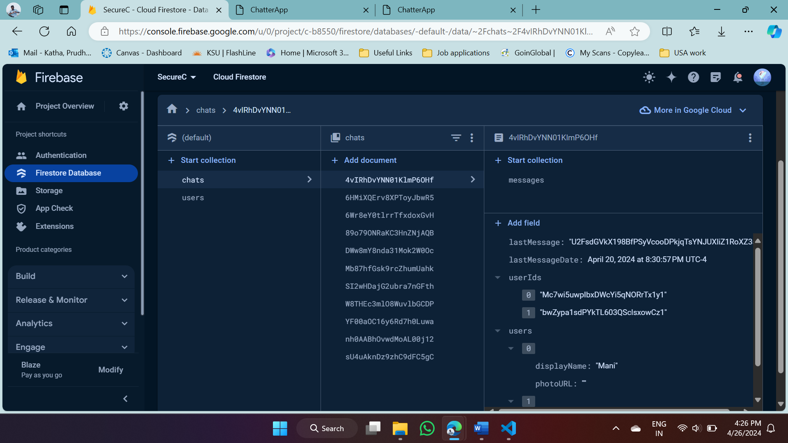
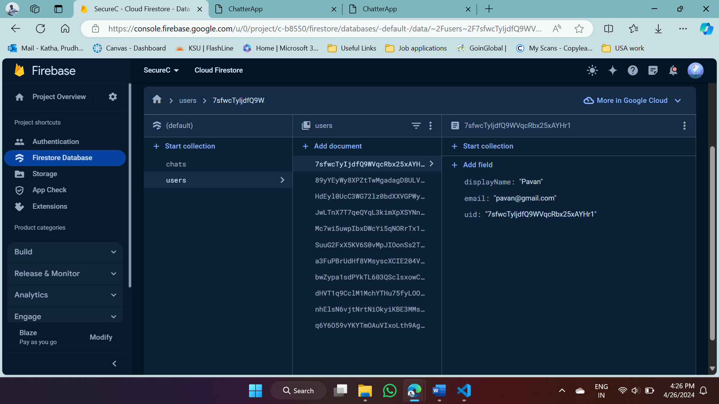
End to end encryption
How does it work in our case?
Being a chatting application all the messages should be encrypted only those who are intended to see it will see it. Both of them share an encryption key without even involvement of the third party.
Here sender encrypts using recipients public key, that message can be decrypted using recipients private key. The message is transferred over network, since its encrypted meaning it is converted to cipher text which is unreadable.
Here we have successfully implemented it in Angular components where the service provider firebase can not see the messages we share. All the data is encrypted.
Notes:
End to End Encryption where only the intended users are allowed to see or has the access to see the messages. No third party , not even the service provider will be able to see the messages. All the data is encrypted or a plain text is visible.

Slide 9
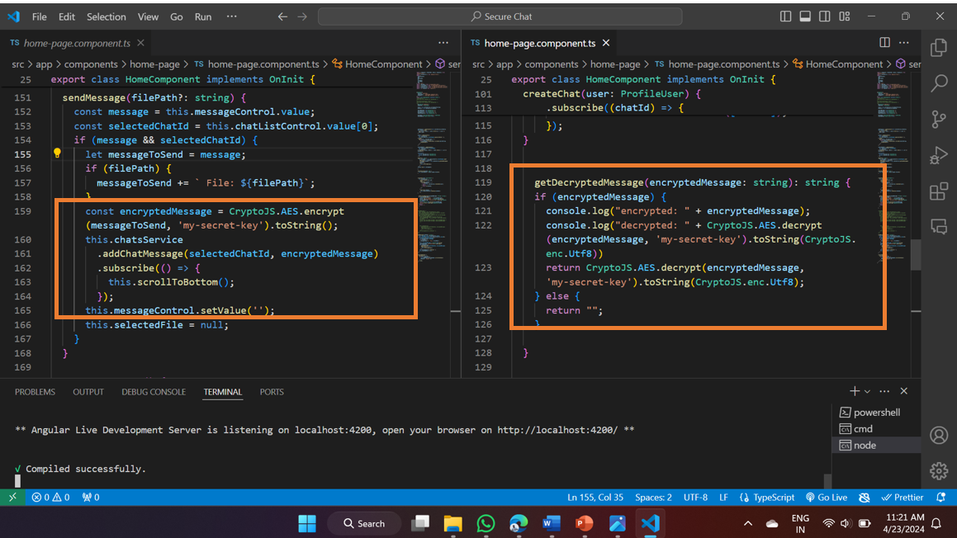
AES – Algorithm
How have we used?
We used AES Block cipher techniques where the data is divided in to fixed size blocks for encryption usually each block of 128 bits. Each block is encrypted independently. We use same secret key used for encryption and decryption.. Since our project is a chat application, messages should be encrypted and transferred accordingly. Here we have used End to End Encryption, which intern helps us to encrypt at one end and decrypt only at the target.
CryptoJS is a js library used for cryptographic works like encryption, decryption, hashing etc. CryptoJS enables easy implementation of AES in script based applications. Since ours is script based application, we could use it easily. It provides enhanced security & protection to data.
Notes:
AES (Advanced Encryption Standard) is an unique encryption algorithm, mostly used for encrypting or securing data. AES is known for its robust encryption meaning it is difficult to break. It mainly uses a secret key for both encryption & decryption.

Slide 10
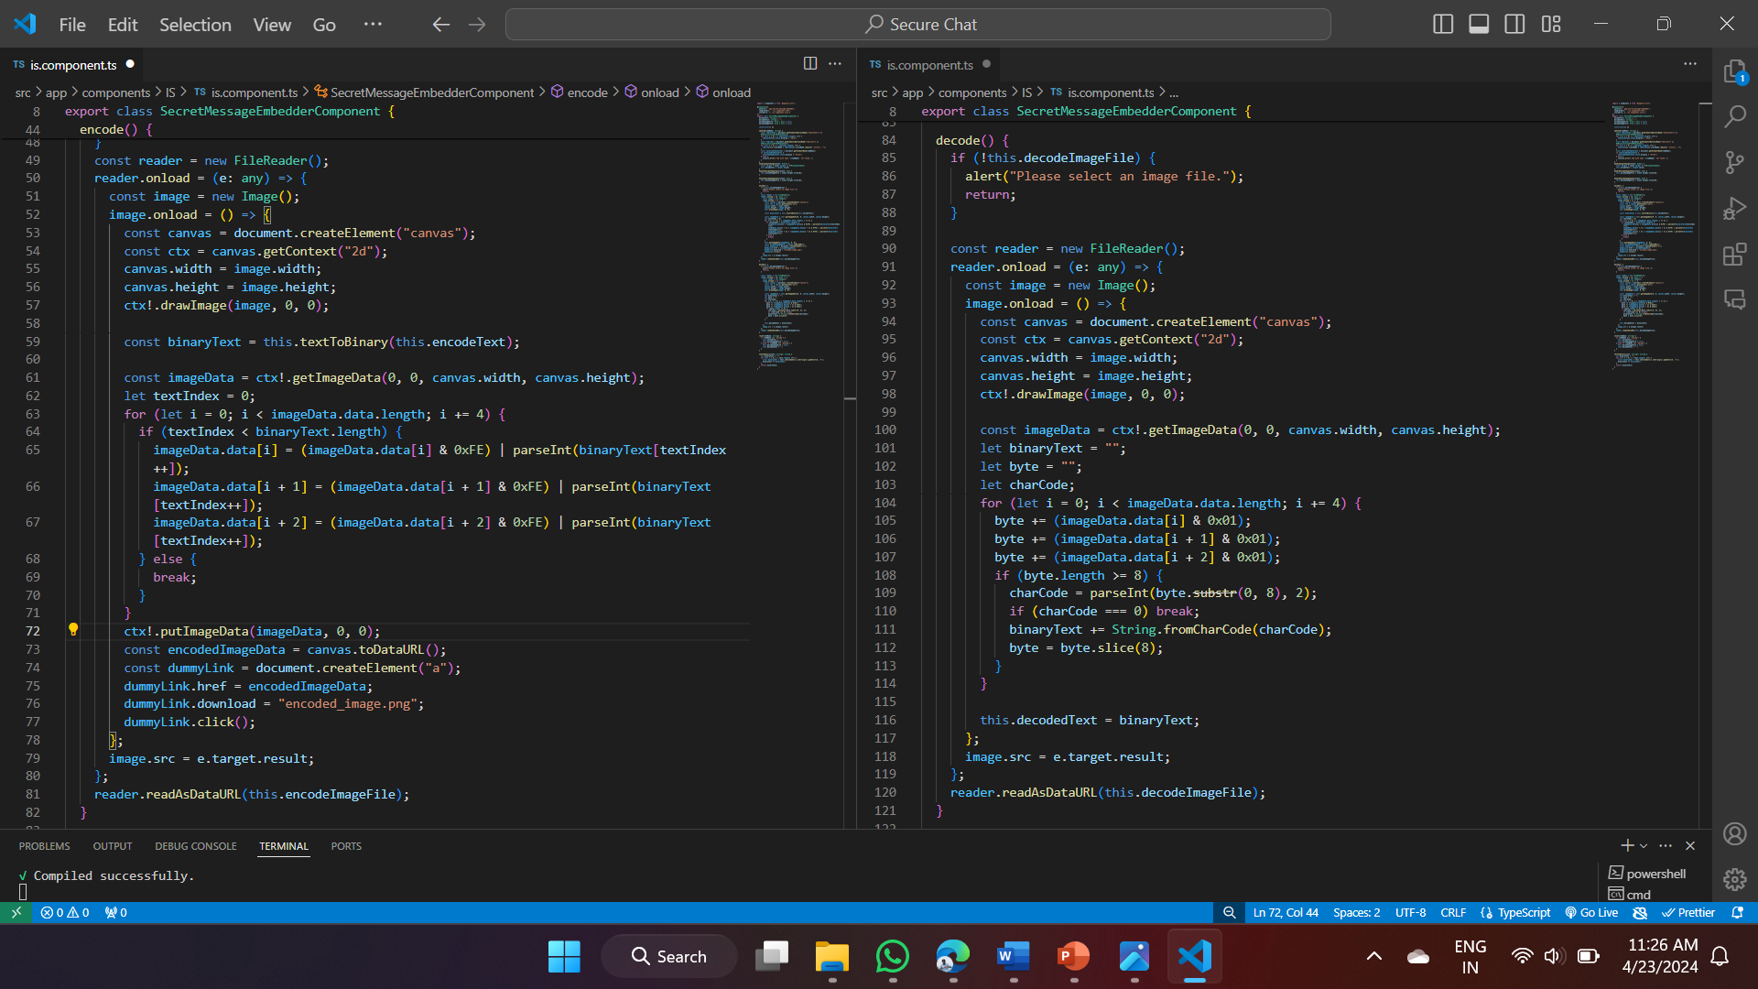
IMAGE STEGANOGRAPHY
Here in this project we have used LSB algorithm to encoding and decoding the text from image.
LSB (Least Significant bit) algorithm is a technique used to hide data in the least significant nit of pixel values with out changing the image structure/appearance.
Each pixel is color coded into RGB values, here in LSB the color component can be changed with out making major changes to pixel’s color.
We then replace the LSB pixels with secret message bits, thus message can be encoded in to image.
On the other end it looks for a message in the same LSB location which is implemented in decode function.
Notes:
The technique of steganography, which improves the security of data transmission processes, is a crucial tool for digital communications.
It is especially appropriate to apply steganography for digital communications when RGB images have a number of color channels such as red, green and blue.
Steps:
Message Encoding:
Convert the secret message into binary format.
Divide the message into small chunks.
Image Selection:
Choose an appropriate cover image for embedding the message.
Larger images with high complexity are preferred to conceal the message effectively.
LSB Embedding:
Iterate through pixels of the cover image.
Modify the LSB of each color component to match the message bit.
Repeat until all message bits are embedded.
Stego Image Generation:
Save the modified pixel values as a new image (stego image).
The stego image visually appears the same as the cover image, but it contains hidden data.
Message Extraction:
Iterate through pixels of the stego image.
Extract the LSBs from each color component to reconstruct the binary message.
Message Decoding:
Convert the extracted binary message back into its original form.

Slide 11
Challenges & Limitations
Connectivity issues with angular and Firebase
Working with large amount of code often brings confusion, even simple things are changed it effects application running.
This application is limited to some features only, these are some of the limitations of this secure chat application
The application needs internet to run
Even provided with most security features, there is always room for some security concerns like having weak password, unauthorized login, defected systems etc.
Secure Chat application lacks emotional indicators, such as voice tone, facial expressions, and body language, that are present in face-to-face interactions. This might make understanding the message difficult and lead to misunderstanding.
Notes:
Main challenges faced during the project was connecting angular and Firebase since there were most of the version dependencies, API connection errors, routing module errors.
Working with large amount of code often brings confusion, even simple things are changed it effects application running. This application is limited to some features only, these are some of the limitations of this secure chat application
The application needs internet to run (to send message, store in online database). which may be a barrier for those with limited internet access.
Even provided with most security features, there is always room for some security concerns like having weak password, unauthorized login, defected systems etc.
This is sample web application is not included with any audio video calling functionality
Secure Chat may not provide the same functionality as email or video conferencing. File sharing is also not accepted.
Secure Chat application lacks emotional indicators, such as voice tone, facial expressions, and body language, that are present in face-to-face interactions. This might make understanding the message difficult and lead to misunderstanding.

Slide 12
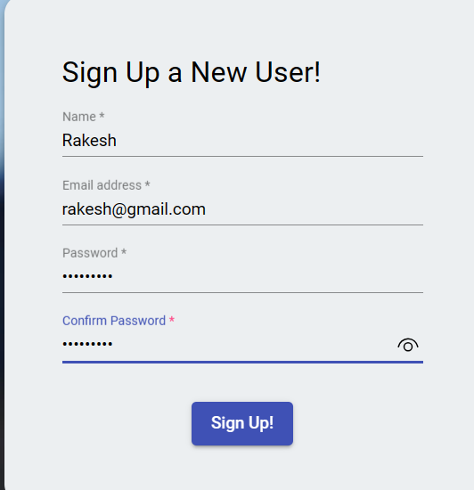
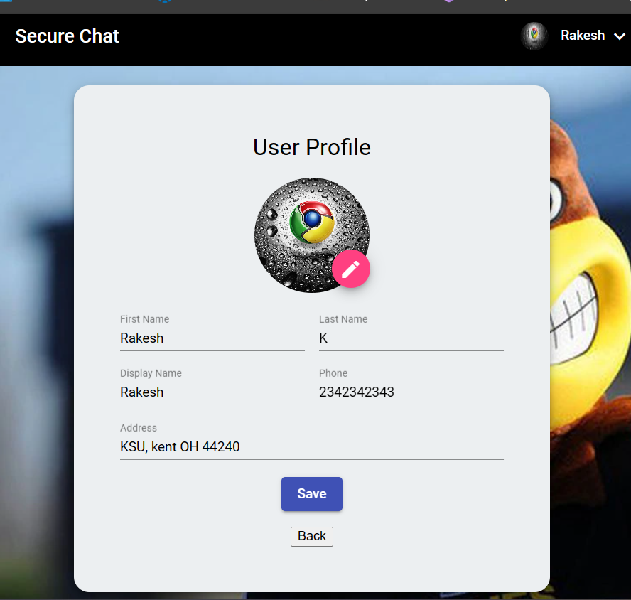
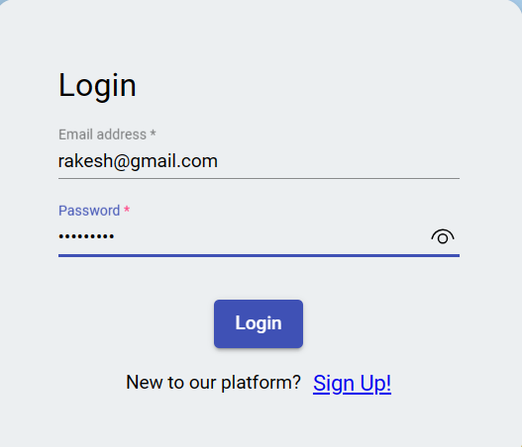
Outputs
Sign-up Screen
Login Screen
Profile Screen

Slide 13
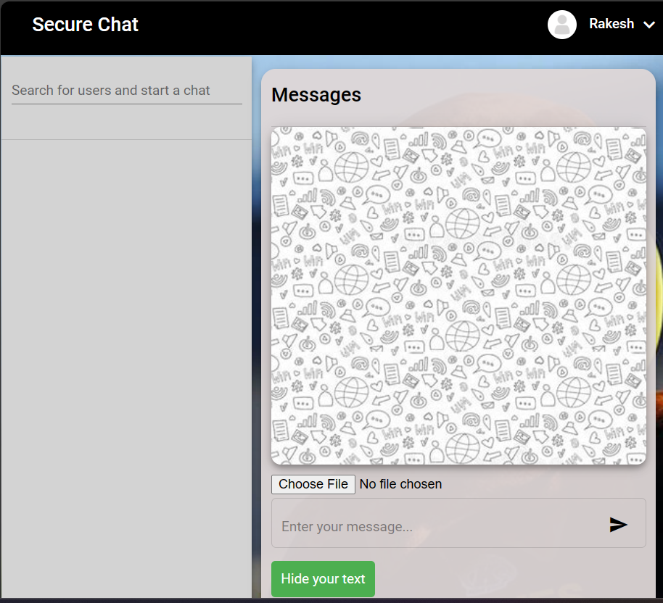
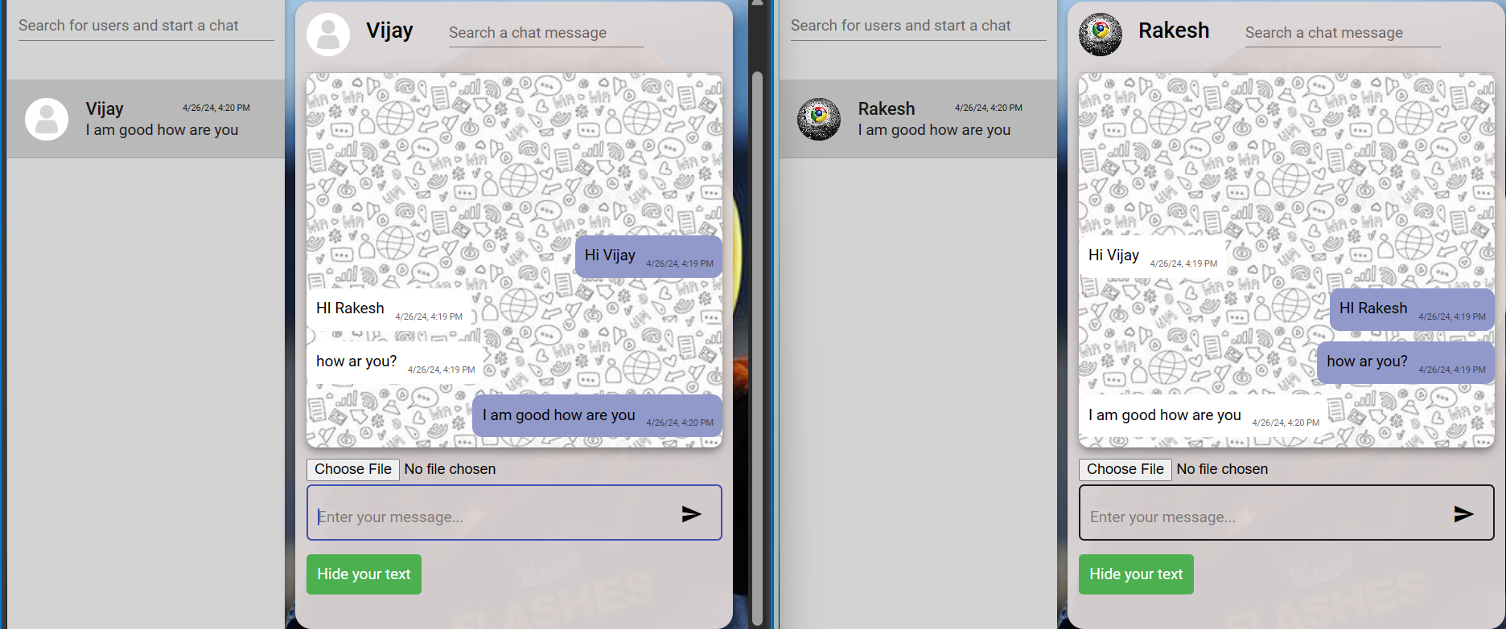
Outputs
Sample Message Screen
Two way message sharing – chat screen

Slide 14
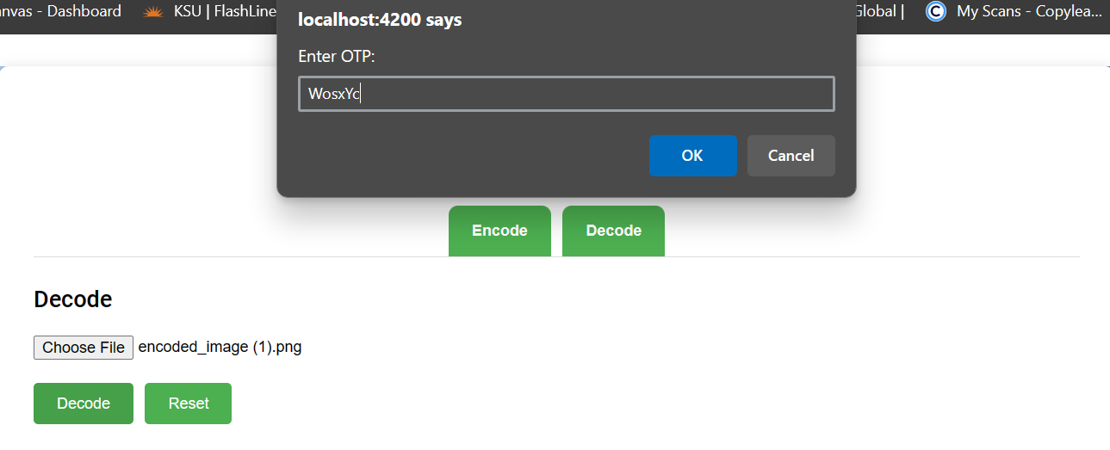
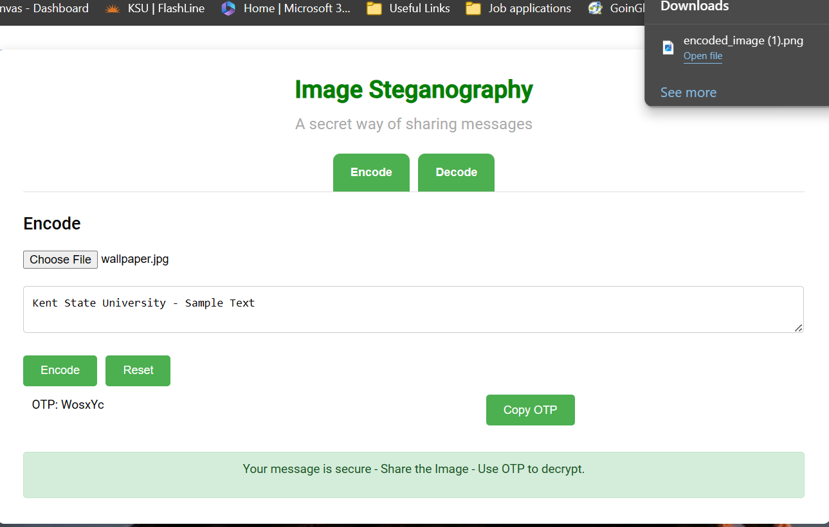
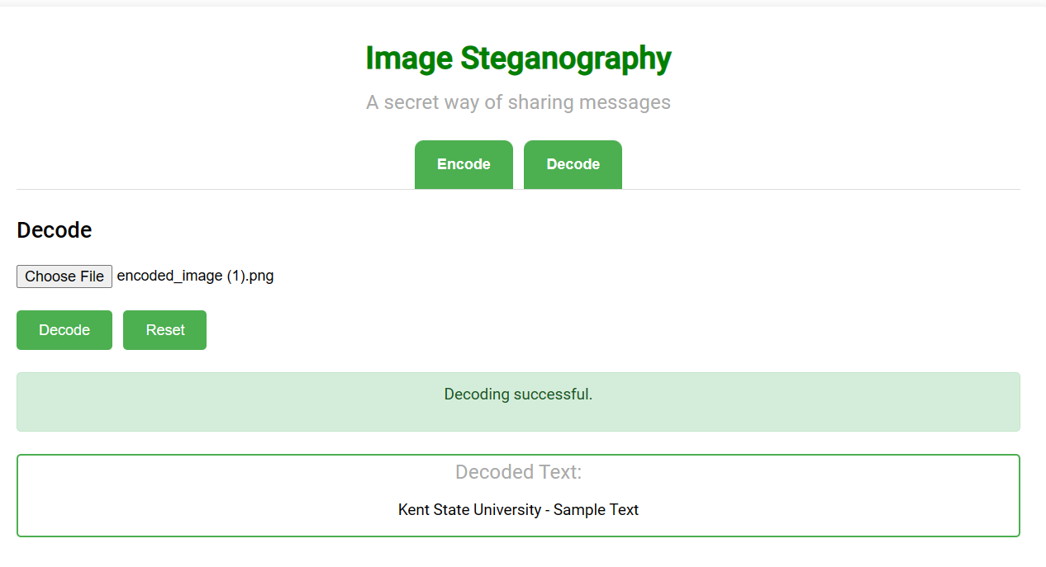
Image Steganography - Outputs
OTP request to decode text
Text encoding screen
Successful decoding Screen

Slide 15
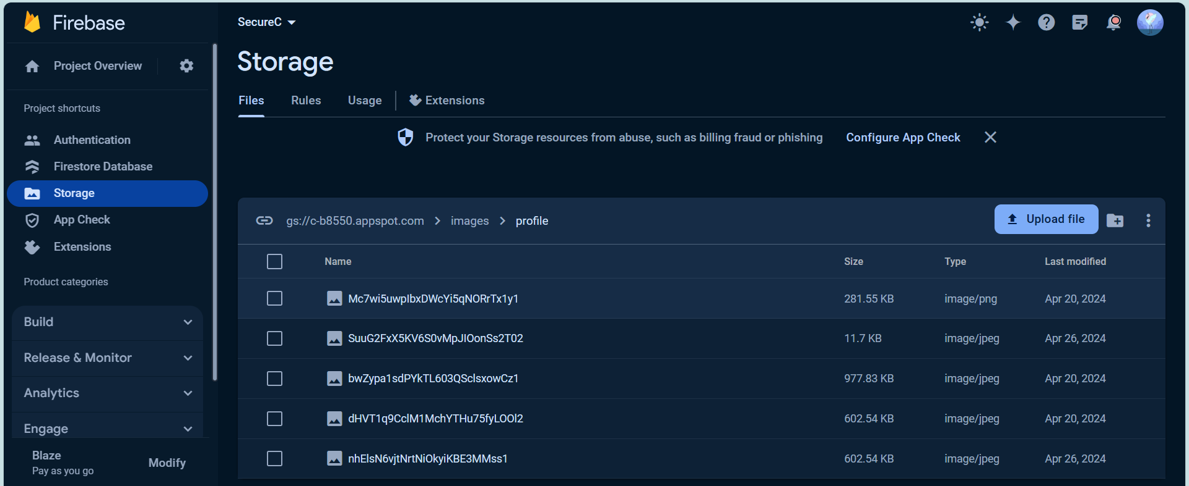
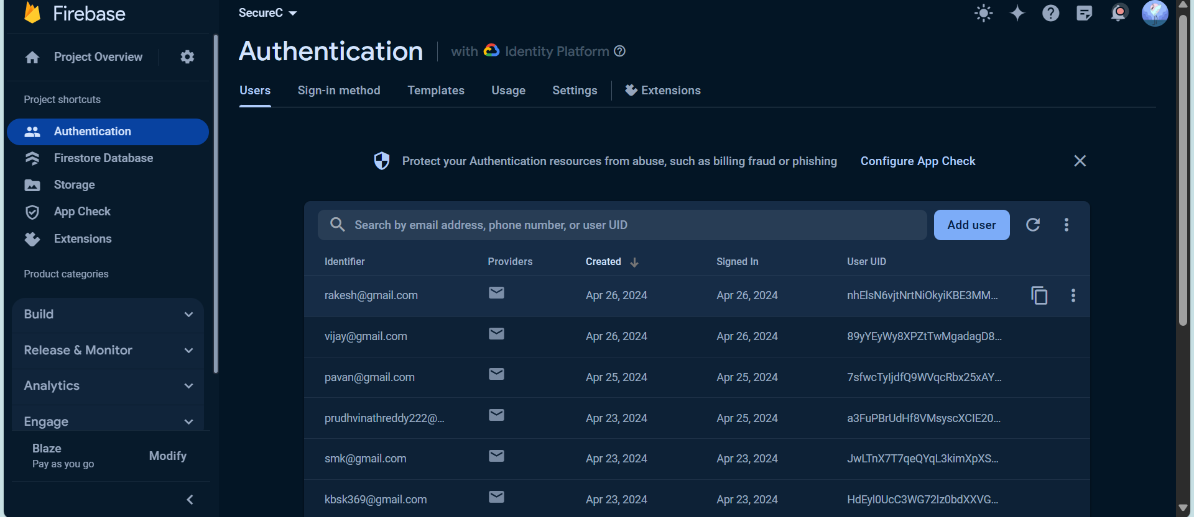
Image Steganography - Outputs
Chat data stored in database after encryption
Image Storage – profile and chat images
Authentication – signed up users
Profile details stored in database after encryption

Slide 16
Future Work
We can make additional functionalities in future for this Secure chat web application. Some of them are:
Adding voice/ video calling functionality, image editing function, sending messages in different font styles, emojis etc.
Animation to GUI, allow users to share large size data files with ease.
Creating groups, Work on Image steganography like adding extra layer of protection to decrypt a message (like giving a QR code to scan the image verify the user and then decrypt the image to get the hidden text).
Allow access to share multiple images at once.
Camera access to take instant pictures and send in chat, news feed option to get more access to the world.

Slide 17
CONCLUSION
During the design phase, the project has successfully fulfilled all user requirements and prioritised data integrity and avoidance of redundancies. Team successfully developed a chat application along with an added feature of Image steganography. The interface is user friendly, with technical details and interactions aimed at making users feel comfortable using the system. A demo is provided, although this may not be necessary in view of the user oriented approach. The system is also flexible, which allows for changes to be made without having an impact on the functionality. The app is compatible with any version of the android operating system, making it available to users that have a different level of device capability. Our main focus was on storage & security. We achieved it by using firebase for our storage, authentication and AES for security of messages on both ends.

Slide 18
REFERENCES
Nurhayati, Kastari and F. Fahrianto, "End-To-End Encryption on the Instant Messaging Application Based Android using AES Cryptography Algorithm to a Text Message," 2022 IEEE, 10th International Conference on Cyber and IT Service Management (CITSM), Yogyakarta, Indonesia, 2022, pp. 01-06, doi: 10.1109/CITSM56380.2022.9935963. e2ee_documentation.pdf
Neogi, Pinaki Prasad Guha. "A Dive into WhatsApp's End-to-End Encryption." arXiv preprint arXiv:2209.11198 (2022). WhatsApp’s E2EE.pdf (arxiv.org)
Williamson, J. a. (2021). The Role of Multi-factor Authentication for Modern Day Security. Semiconductor Science and Information Devices, 03(01). Retrieved from Multifactor_authentication.pdf (researchgate.net)
Maliheh Shirvanian and Shashank Agrawal. 2021. 2D-2FA: A New Dimension in Two-Factor Authentication. In Proceedings of the 37th Annual Computer Security Applications Conference (ACSAC '21). Association for Computing Machinery, New York, NY, USA, 482–496. Doi: https://doi.org/10.1145/3485832.3485910 2FA_ACM_documentation.pdf
N. Subramanian, O. Elharrouss, S. Al-Maadeed and A. Bouridane, "Image Steganography: A Review of the Recent Advances," in IEEE Access, vol. 9, pp. 23409-23423, 2021, doi: 10.1109/ACCESS.2021.3053998. Image_steganography_IEE
P. Chandani and M. Sharma, "Secure Data Transmission using Cryptography for Internet of Things and Sensor Networks Applications," 2023 2nd International Conference for Innovation in Technology (INOCON), Bangalore, India, 2023, pp. 1-7, doi: 10.1109/INOCON57975.2023.10101069. Secure Data transmission

Slide 19
Thank You..!
GROUP – 8
pkatha@kent.edu
msutapal@kent.edu
vdurgesa@kent.edu

